Slide 1

Microsoft Movie Analysis
Investing in The Big Screen

Slide 2
The Purpose:
Provide actionable insights for profitability that a company like Microsoft could use to venture into the movie industry.

Slide 3
Considerations Before Investing
Demography of its target audience.
Customer satisfaction.
Segmenting audience with language preferences.
Release Month.
Gross value.

Slide 4

Data Used:
Box Office Mojo Movie data
Internet Movie Database data
The Movie Database

Slide 5
Strategy for Analysis:
Performing Exploratory Data Analysis to maximize the insights into data .
Generate summary statistics for numerical data.
Create graphical representations to understand the data better

Slide 6

Observations

Slide 7
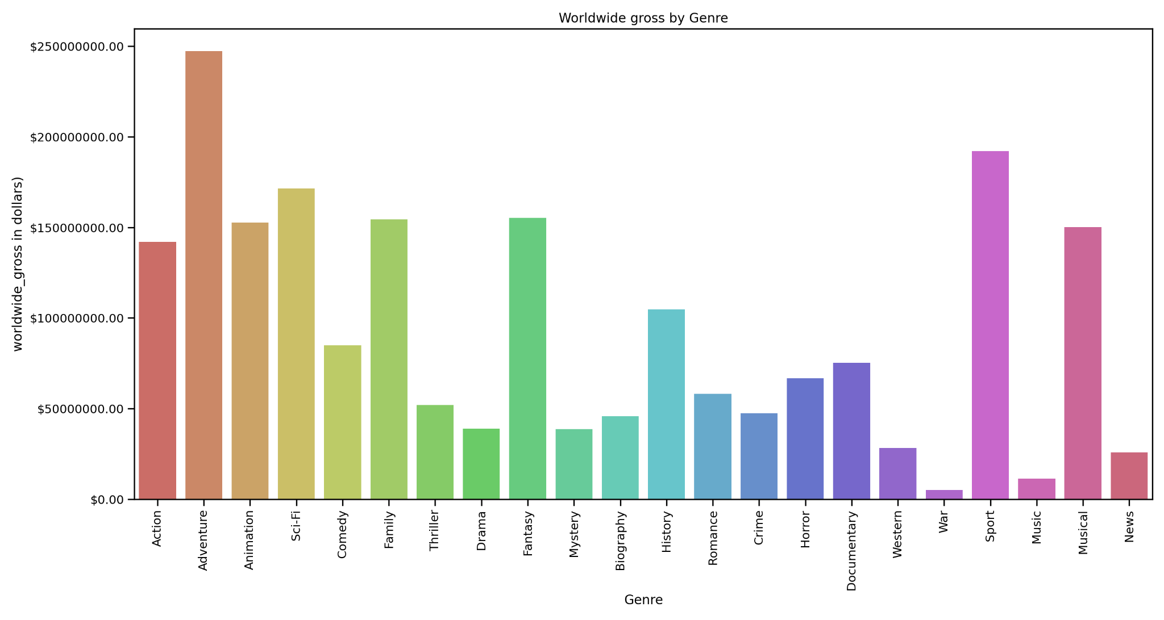
Observation 1:
Genre generating the highest worldwide gross:

Slide 8
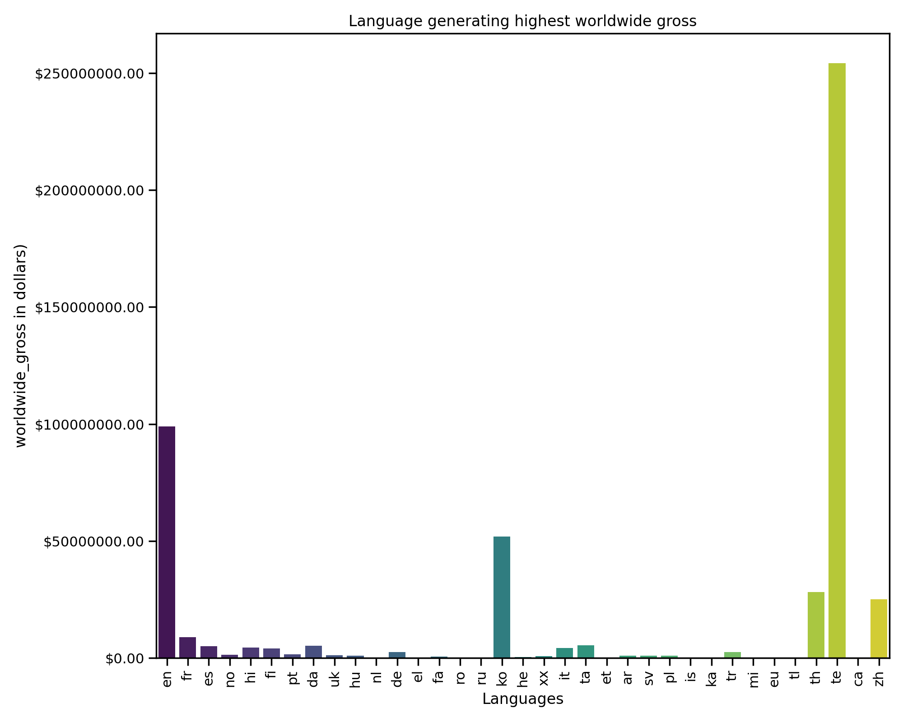
Observation 2:
Language generating the Highest Worldwide Gross:

Slide 9
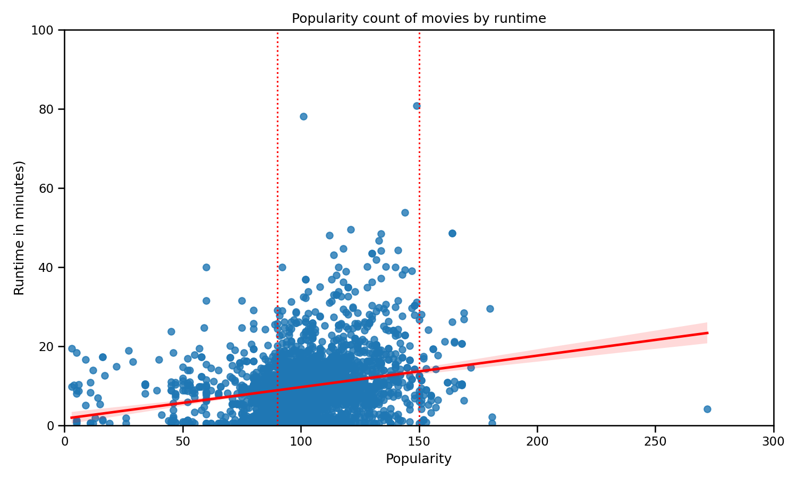
Observation 3:
Correlation between runtime & popularity count

Slide 10
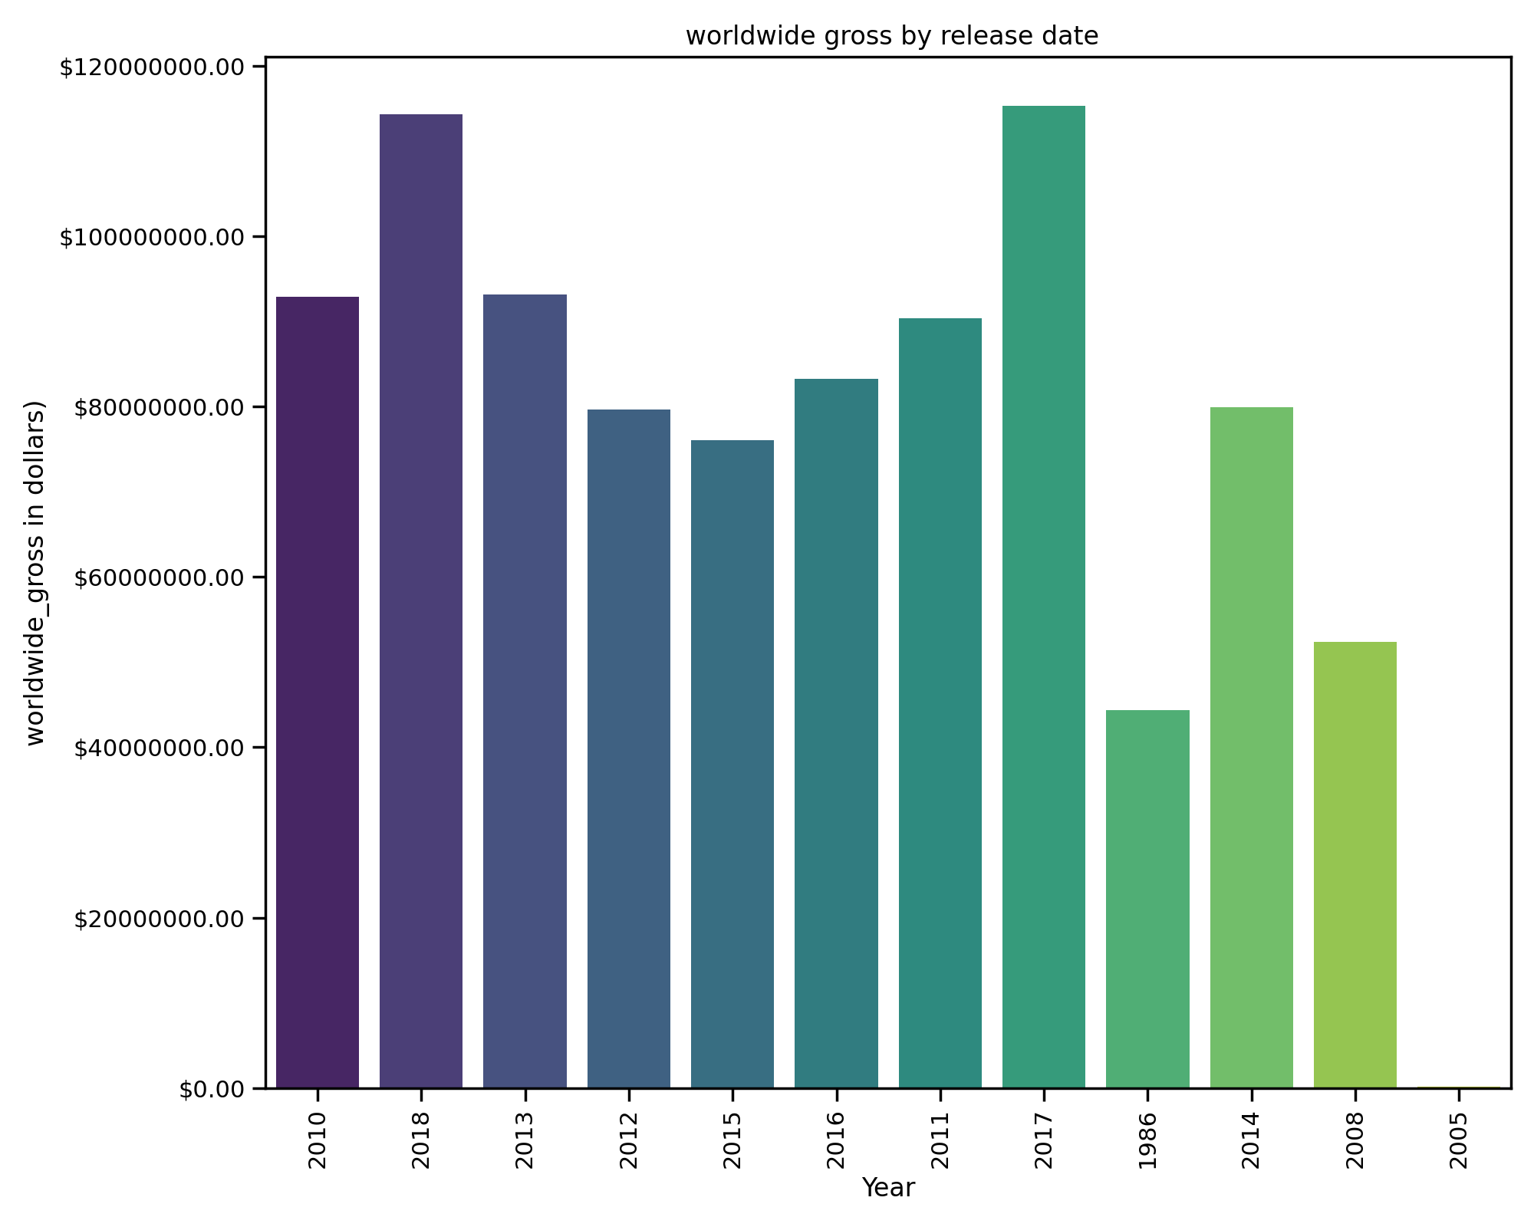
Observation 4:
Most profitable year for the business.

Slide 11
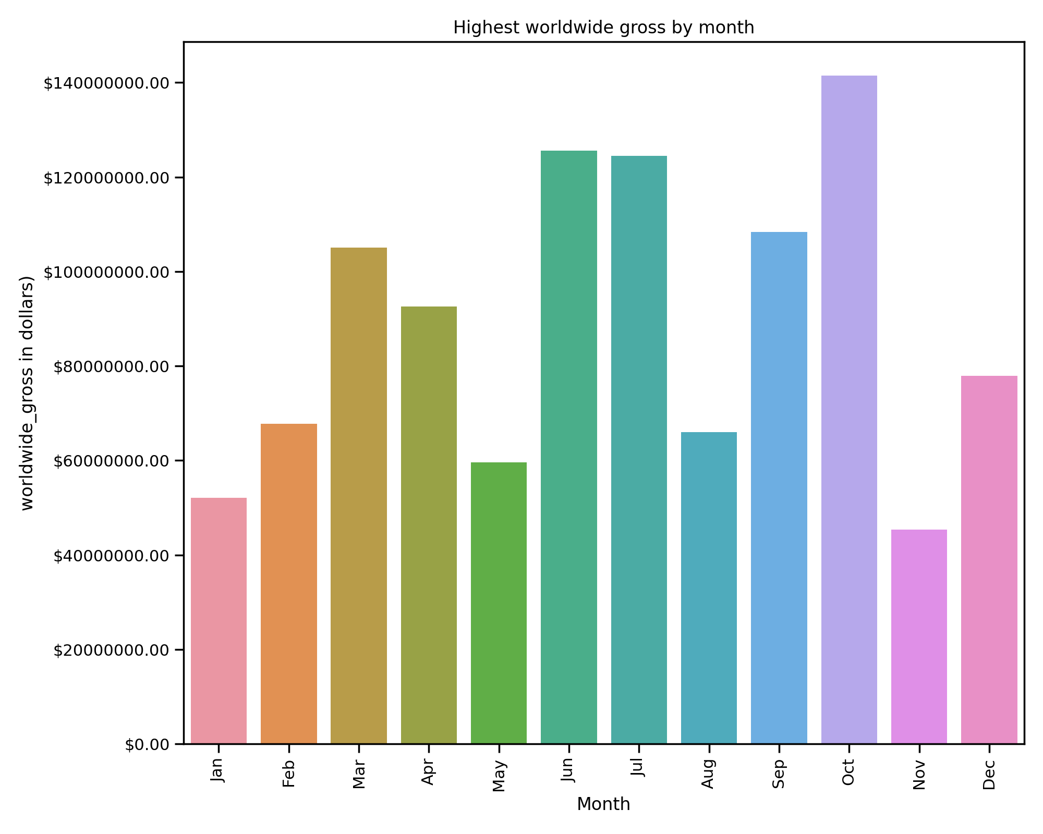
Observation 5:
Release Month that gathers the highest Worldwide Gross.

Slide 12
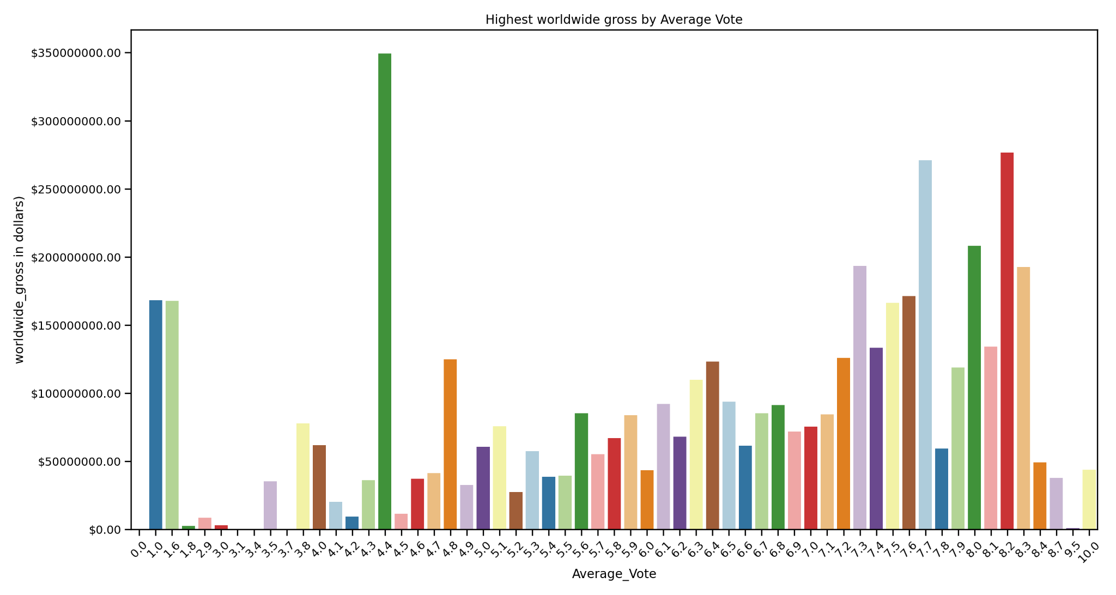
Observation 5:
Average_vote that generates highest Worldwide Gross

Slide 13
Our Findings:
Movie Genre: Adventure
Preferred Language: te
Popularity with Runtime: Positive Correlation within a frame.
Release Month
Average_Vote count matters

Slide 14
Recommendations
Focus on Movie Genre.
Runtime should not be overlooked
Movies with Average vote count seems to be doing well.
Release Time of Movie is important.
Knowing language preferred by your audiences matters.

Slide 15


